Slide 1
Deep Features
In this presentation, a several classifiers were developed for person verification using Deep features.
Aim 1: To compare different Deep features ​
Aim 2: To compare conventional classifiers based on these features
Notes:
In this worksheet, a template matching model for verification task was developed.
The aim of this worksheet is to find the best model based on two different score matrixes.
In addition, we are going to compare COP and COA features.

Slide 2

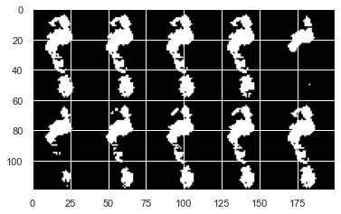
Processing Pipeline 1: Pre-Feature Extraction​
3D .
footprint* .
(60,40,100)
Extracting 10 pre-features for each sample
(60,40,10)
Concatenating Image features
(120,200,1)
Image features
* CASIA-D Dataset: 97 subjects, 2851 samples
* Pre-features are CD, PTI, Tmax, Tmin, P50, P60, P70, P80, P90, P100
Notes:
Let start with the block diagram of the feature extraction.
As you can see, at first, I extracted the COP time series from each sample.
in the next couple of slides, we can see these signals.
Then these were passed through a low-pass filter.
with cut-off frequency of 5-Hz.
Finally, 26 handcraft features were extracted.
So each 3D sample translated to a 26-element vector.
+/-4.1 (18, 54)

Slide 3
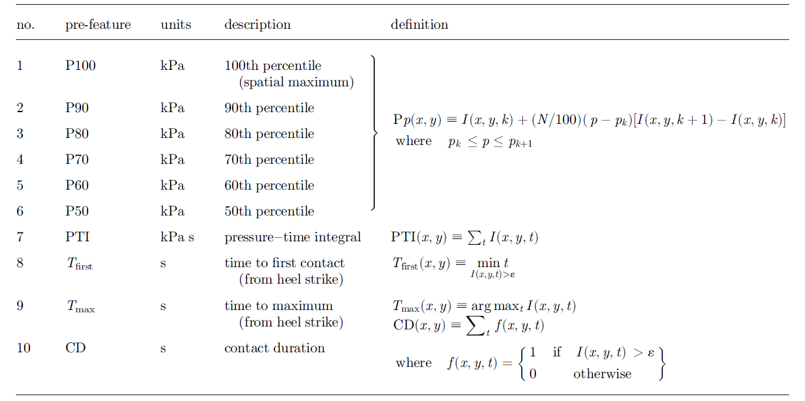
Processing Pipeline 1: Pre-Feature Extraction​
CD, PTI, Tmax, Tmin, P50,
To plot all features on an image, those changed to binary images.
P60, P70, P80, P90, P100
Notes:
Let start with the block diagram of the feature extraction.
As you can see, at first, I extracted the COP time series from each sample.
in the next couple of slides, we can see these signals.
Then these were passed through a low-pass filter.
with cut-off frequency of 5-Hz.
Finally, 26 handcraft features were extracted.
So each 3D sample translated to a 26-element vector.
+/-4.1 (18, 54)

Slide 4
Processing Pipeline 1: Deep Feature Extraction​
preprocessing
Image features
Casting to tf.float32
(120,200,1)
Reshape to (120,200,3)
(120,200,3)
preprocess_input
CNN
Based CNN Model *
GlobalMaxPooling2D
Deep features
* Based CNN Model: EfficientNetB0, VGG16, ResNet50, MobileNet, InceptionV3
Notes:
After extracting features, normalization and PCA were applied to these feature types.
In the next slide, I’d like to talk more about this red box.
Also, for comparing models, the accuracy was calculated.

Slide 5
Processing Pipeline 2: Feature Evaluation​
Enrollment Process
Deep features
Splitting test and training set
Normalization & PCA
Train SVM, KNN or Template Matching
Verification Process
Test set
Normalization & PCA
classifier
Calculating Accuracy, F1-score, FRR and FAR
Notes:
After extracting features, normalization and PCA were applied to these feature types.
In the next slide, I’d like to talk more about this red box.
Also, for comparing models, the accuracy was calculated.

Slide 6
Processing Pipeline 4: Verification Process​
Test Set
Training se
Client samples
Test Set
Verification Process
Client samples
SVM, KNN or Template Matching
Calculating Accuracy, F1-score
Imposter samples
Randomly
Computing the average of Accuracy, F1-score
Imposter samples
It would repeat 50 times.
Notes:
Here we can see the same method that I have used for the verification process.

Slide 7
Conditions for Worksheet 3​
Classifier
SVM
Deep features
vgg16
KNN
Template Matching
inception_v3
efficientnet
Resnet50
mobilenet
Notes:
As I said before, our purpose is to compare several algorithms to find out which one has the best performance.
So, This table shows the search space for this worksheet.

Slide 8
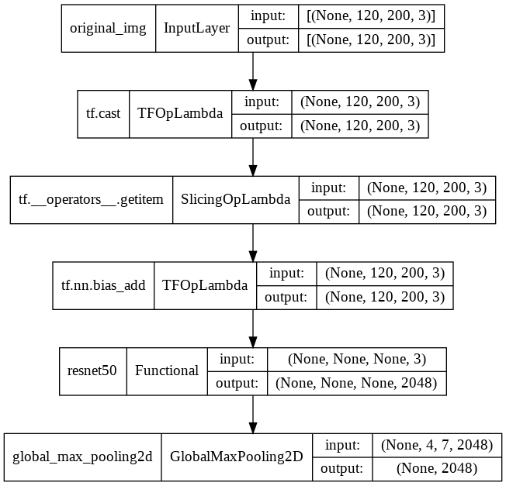
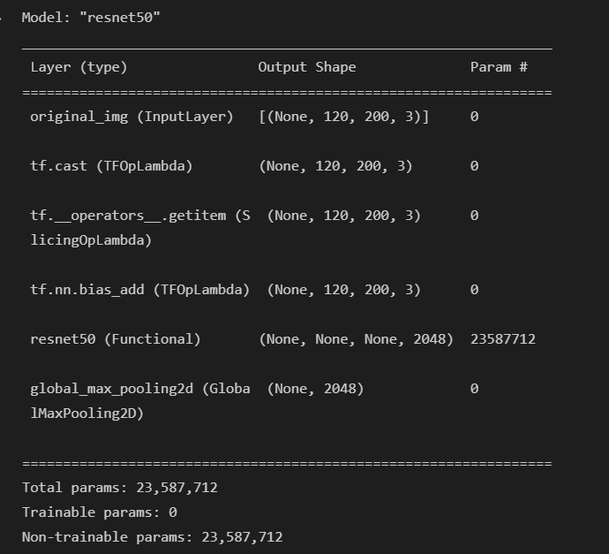
ResNet50
Notes:
slide 29 & 30
here is a boxplot of accuracy and ROC curve.

Slide 9
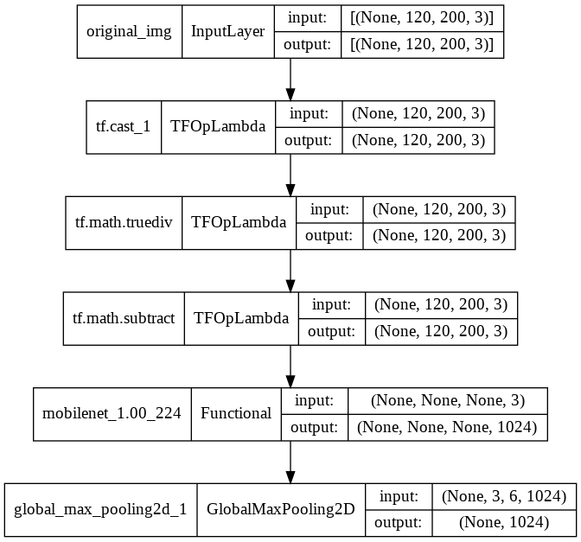
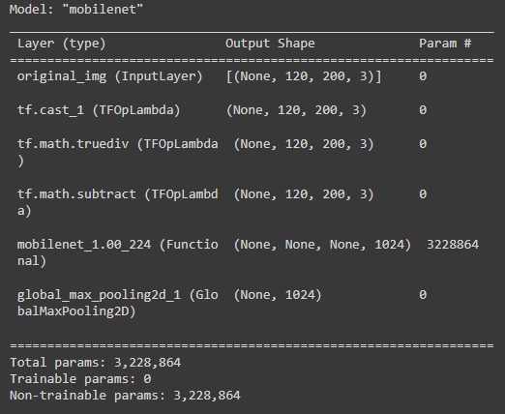
Mobilenet
Notes:
slide 29 & 30
here is a boxplot of accuracy and ROC curve.

Slide 10
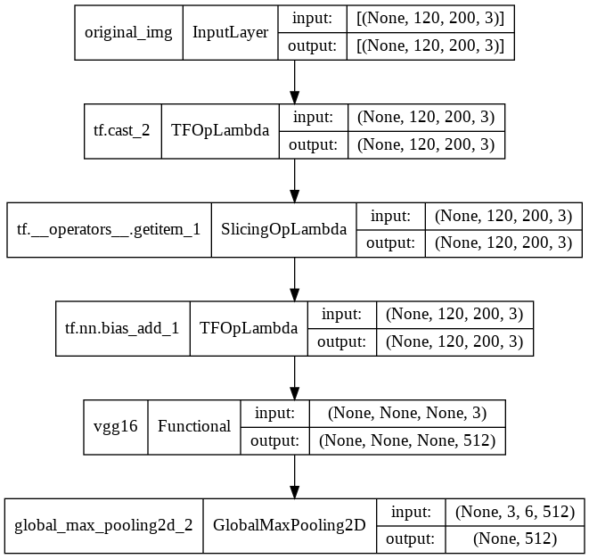
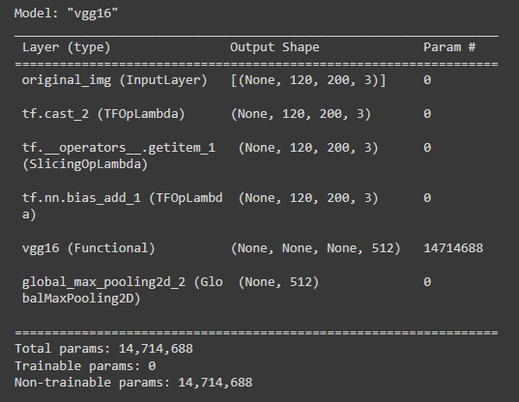
VGG16
Notes:
slide 29 & 30
here is a boxplot of accuracy and ROC curve.

Slide 11
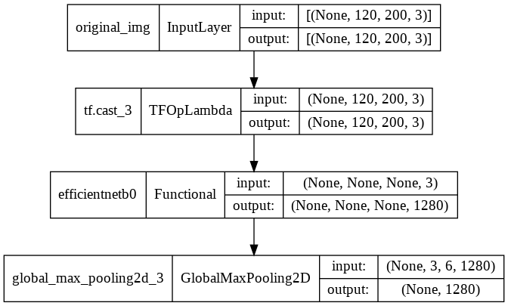
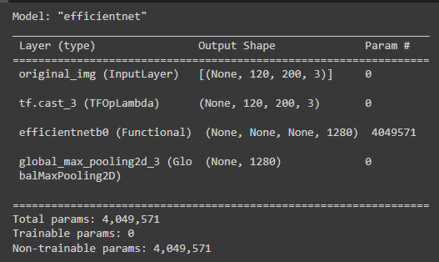
Efficientnet
Notes:
slide 29 & 30
here is a boxplot of accuracy and ROC curve.

Slide 12
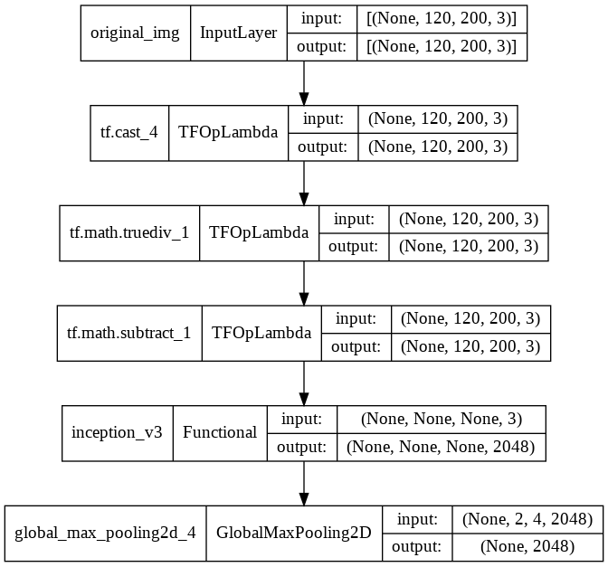
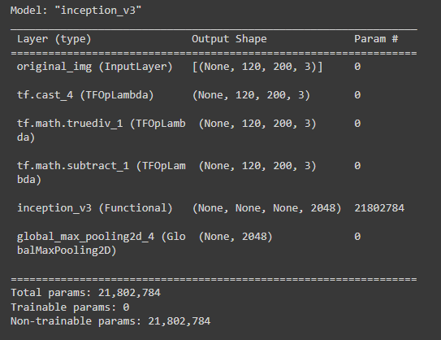
InceptionV3
Notes:
slide 29 & 30
here is a boxplot of accuracy and ROC curve.

Slide 13
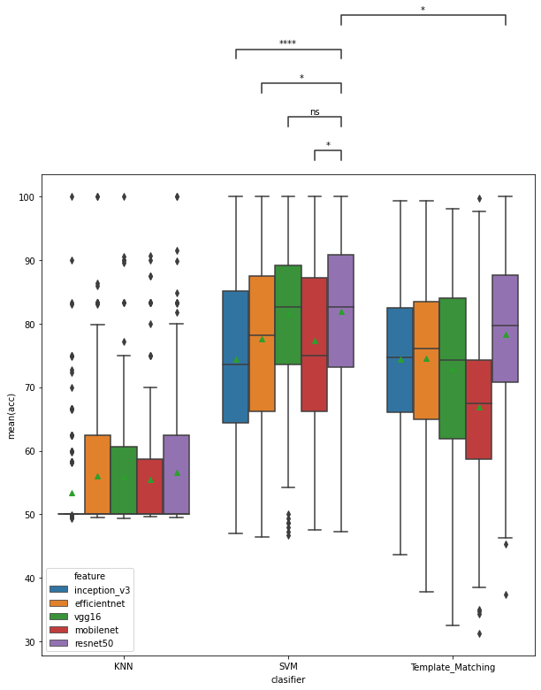
Deep features
Statistical test: Mann-Whitney
p-value annotation legend:
ns: 5.00e-02 < p <= 1.00e+00
*: 1.00e-02 < p <= 5.00e-02
****: p <= 1.00e-04
Notes:
slide 28
about PCA, the performance of models decreased since we lost some variance.
But I think keeping 95 percent could be a good choice
because it reduces feature space by about one-fourth with the same accuracy as without PCA.

Slide 14
Conclusions
SVM has a better result than TM and KNN.
PCA with keeping 95% was applied since it reduced the feature space.
Z-score has been applied on all features.
30% test size provided for calculating the accuracy.
VGG16 and Resnet50 have the best performance on all classifiers.
KNN has the worse results.

